Slide 1
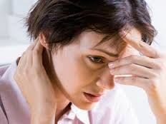
Discussion
What are the most serious kinds of problems? Rank the following kinds of problems from most serious (1) to least serious (8). Share your answers with your partner and explain.
___ Romantic Relationship
___ Family
___ Health
___ Friendship
___ School
___ Appearance
___ Crime
___ Money
I ranked friendship number one because…..

Slide 2
What’s the problem?
not enough homeworks?
too many homeworks?
enough homework?
too much homework?

Slide 3
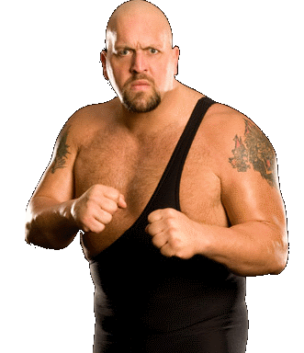
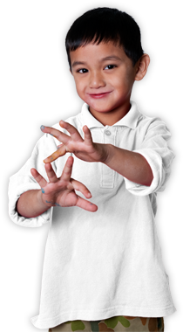
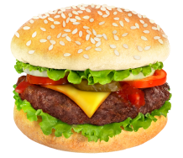
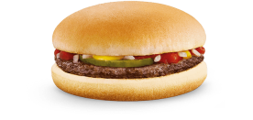
too many / too much / enough
not enough
enough
too many

Slide 4
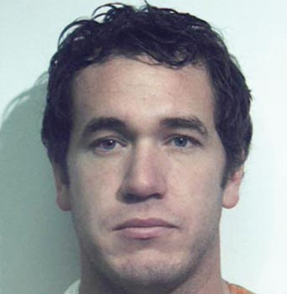
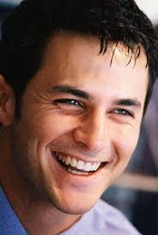
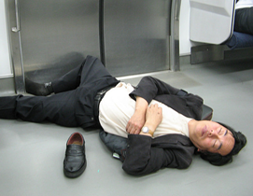
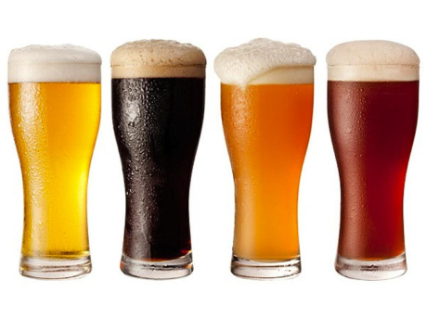
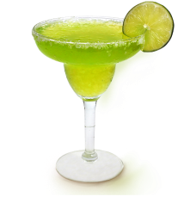
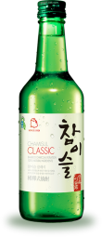
too many / too much / enough
not enough
enough
too much

Slide 5
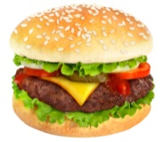
too many
1. We use “too many” before plural countable nouns.
Tony’s mom gave him too many hamburgers for lunch.
The exam had too many questions!

Slide 6
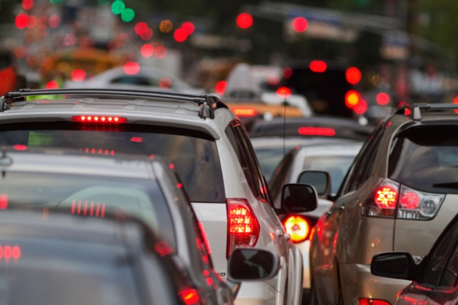
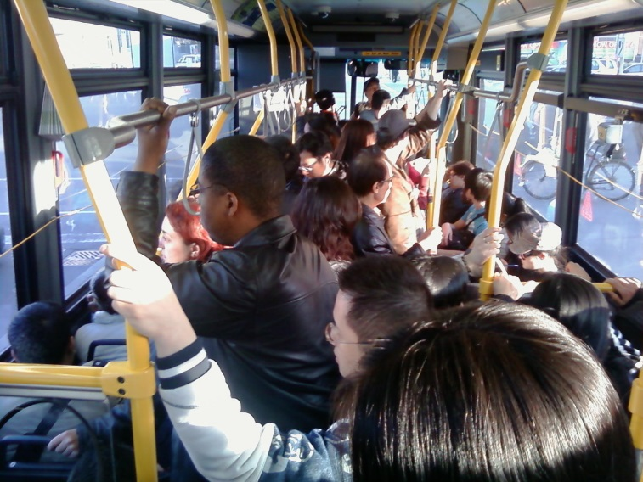
too many
2. “Too many” means “a lot” in a negative way.
Gangnam always has too many cars.
There are too many people on the bus.

Slide 7
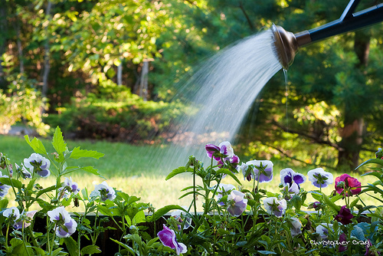
too much
1. We use “too much” before uncountable nouns.
He has drunk too much soju.
Don’t put too much water on the plants.

Slide 8
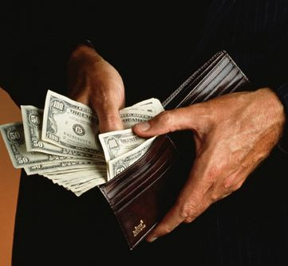
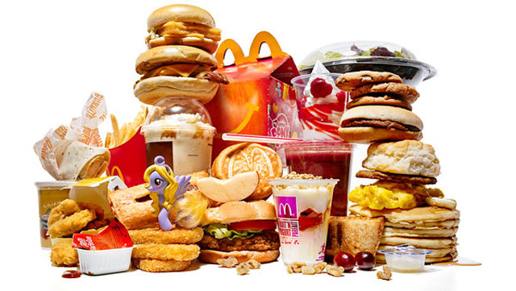
too much
2. “Too much” means “a lot” in a negative way.
I spent too much money last night.
He eats too much fast food.

Slide 9
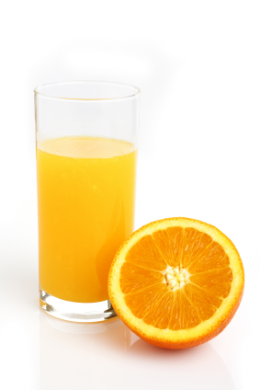
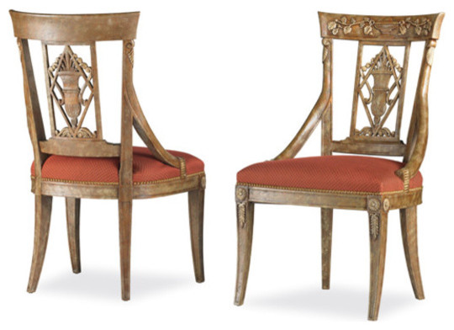
enough
1. We use “enough” or “not enough” before nouns.
We have enough juice for ten people.
There aren’t enough chairs for everyone.

Slide 10
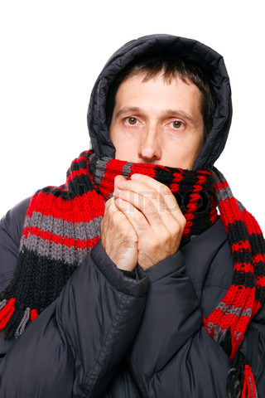
enough
2. We use “not adj. enough” to describe a negative situation.
I’m not tall enough to be a model.
My jacket isn’t warm enough for this cold weather.

